Slide 1
Distributed Databases
(Part 2)

Slide 2
Issues of Distributing a Database
There are additional factors to be considered for the design of a distributed relational database.
More specifically, we discuss the issues of:
data replication
  the DDBMS may contain multiple copies of data at several different sites.
data fragmentation (partition)
  a relation may be divided into a number of sub-relations (fragments), which are then distributed.
distribution transparency
  this allows the users to perceive the distributed database as a single, logical entity.

Slide 3
Data Replication
Among the desirable properties of DDBs is the ability to have a local repository of frequently used data, while still being able to access data stored at other network sites.
Replicated database - is a distributed database where (some) stored data is duplicated at various sites.
Fully replicated database – is a distributed database where all stored data are duplicated and allocated to all sites.

Slide 4
Data Replication – Key Points
Replication has a different effect on read-only and update applications:
  Read-only applications take advantage of replication, which makes it more likely that they can reference data locally.
  Update applications may present problems due to replication, since they must update all copies in order to preserve data consistency.
Replicated data enhances locality of reference by satisfying more read-only queries locally. This reduces the query response time and reduces traffic on the communication network.
Further more, replicated data provides grater reliability through backup copies from which data can be recovered in the event of media failures.

Slide 5
Data Replication – Update Strategies
Proper provision must be made for update operations in a distributed database where data replication is used.
Two of the update strategies:
Unanimous Agreement Update Strategy
Updates are refused unless they have unanimous acceptance from all sites containing a replica.
2. Single Primary Update Strategy
Update requests are issued to primary replica, which serializes all updates.

Slide 6
Data Replication – Update Strategies
2. Single Primary Update Strategy
Under this strategy, one replica is designated as PRIMARY and the remaining replicas as SECONDARYs.
Update request are issued to the primary replica, which serves to serialize updates to the secondary replicas and thereby preserve data consistency.
The secondarys diverge temporarily from the primary. After having performed the update, the primary will broadcast it to all the secondarys at some later time.
There are different proposals for this broadcast:
  broadcast the update requests to the secondarys 'immediately';
  broadcast the updates at the end of the transaction;
  broadcast updates at only specific intervals.

Slide 7
Data Fragmentation
....is basically the dividing of relations into fragments for distribution.
Some advantages
Usage: since applications usually work with views rather than entire relations, it makes sense to use subsets of relations as the unit of distribution.
Efficiency: if the relation can be decomposed into fragments, it is possible to allow a number of transactions to execute concurrently.
Parallelism: parallel execution can be realised whereby a single query can be split into a set of subqueries that operate on fragments.
Some disadvantages
Integrity: integrity checking can be made more complex if data and functional dependencies are fragmented and distributed to different sites.
Performance: it can be slower to process some global applications which require data from fragments located at different sites.

Slide 8
Data Fragmentation – 3 Rules
There are three fragmentation rules which must be followed:
Completeness:
Each data item from a 'global' relation R must appear in at least one of its fragments. This rule ensures no loss of data during fragmentation.
Reconstruction:
It must always be possible to reconstruct each global relation from its fragments. This rule ensures no loss of functional dependencies.
Disjointness:
Each data item from a global relation should appear in only one of its fragments, except for vertical fragmentation where primary key attributes must be repeated to allow reconstruction. This rule ensures minimal data redundancy.

Slide 9
Data Fragmentation – Options
There are usually three fragmentation options:
    Horizontal fragmentation
    Vertical fragmentation
    Mixed fragmentation

Slide 10
Horizontal Fragmentation
A horizontal fragment of a relation R is a subset of the tuples in that relation.
Using the RESTRICT operation, horizontal fragmentation divides a relation horizontally by grouping subsets of tuples, where each subset (fragment) is specified by some condition on one or more attributes of the relation.
These fragments can then be assigned to different sites in the distributed system.
The relation can be reconstructed from its fragments by using the UNION operation to the fragments.

Slide 11
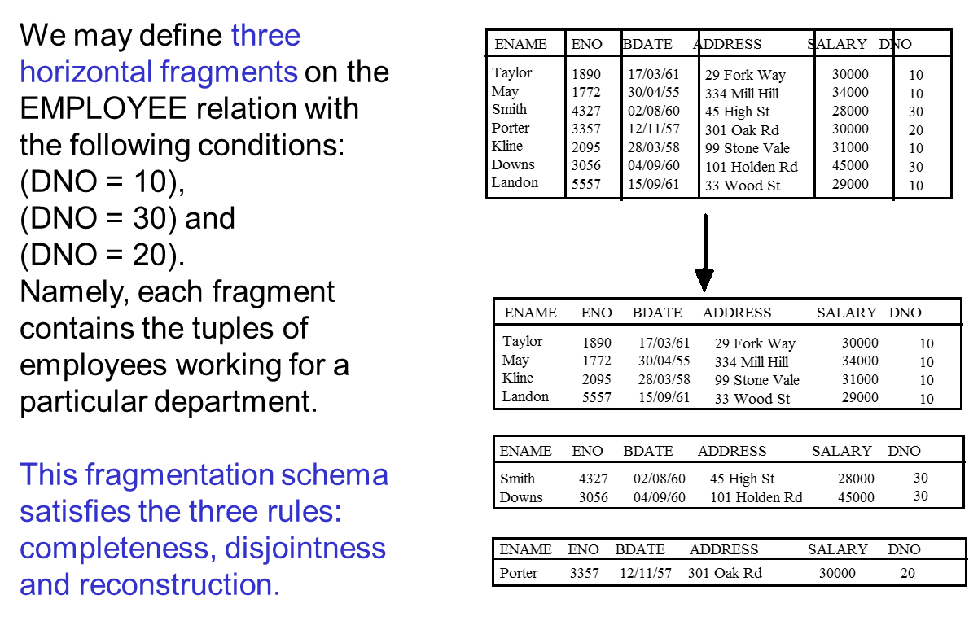
Horizontal Fragmentation – An Example

Slide 12
Vertical Fragmentation
A vertical fragment of a relation R groups together certain attributes in the relation using the PROJECT operation.
With vertical fragmentation, some of the columns of a relation are projected into one fragment and other columns are projected into other fragment(s).
A set of vertical fragments, whose projection lists L1, L2,.... include all the attributes in R but share only the primary key attribute of R, is called a complete vertical fragmentation of R.
To reconstruct the relation R from a complete vertical fragmentation, we apply the natural JOIN operation to the fragments. Therefore, the fragments must share a common attribute (normally the primary key) to enable the original relation to be reconstructed if required.

Slide 13
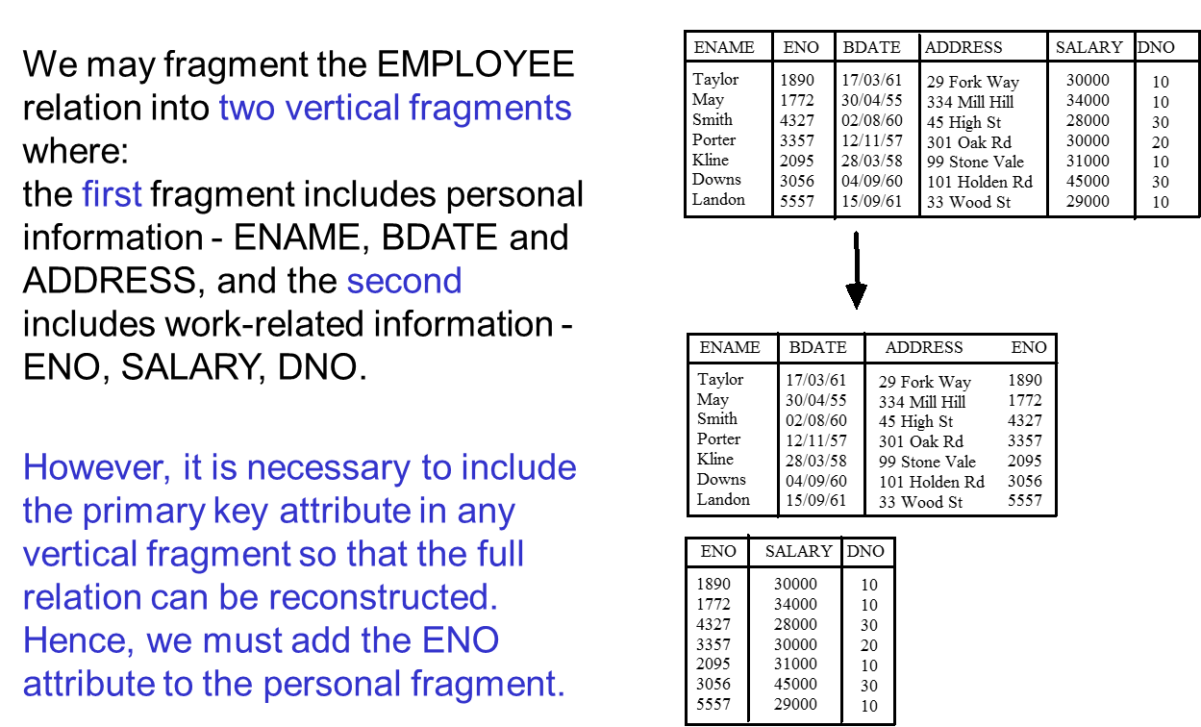
Vertical Fragmentation – An Example

Slide 14
Mixed Fragmentation
We can combine the two types of fragmentation schema discussed above, resulting in a mixed fragmentation.
The original relation can be reconstructed by applying the UNION and JOIN operations to the fragments in the appropriate order.

Slide 15
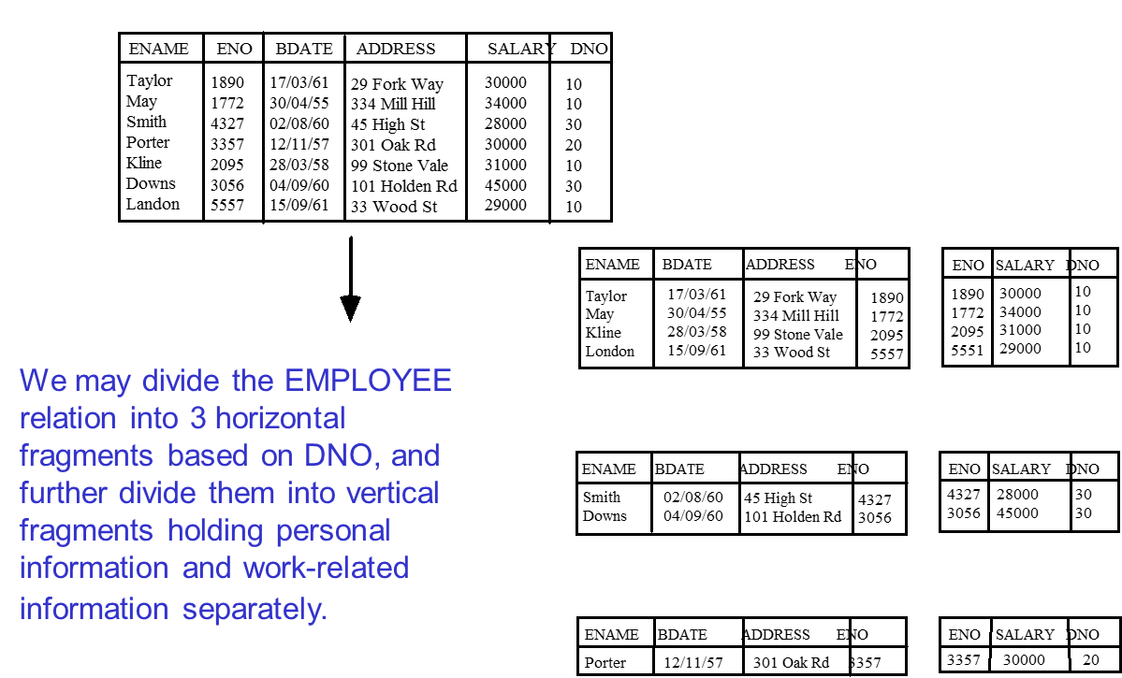
Mixed Fragmentation – An Example

Slide 16
Transparency in Distributed Databases
An important aspects of a distributed database is to hide the details of data distribution from its users. This allows them to perceive the distributed database as a single, logical entity.
Types of Transparency:
  Distribution transparency
  Replication transparency
  Fragmentation transparency

Slide 17
Transparency in Distributed Databases
  Distribution transparency
  The user should write global queries and transactions as though the database were centralized, without having to specify the sites at which the data referenced in the query.
  Replication transparency
  Where data is replicated, the system should handle the management of copies and the user normally should act as if there is a single copy of the data. However, there may be situations where the users should be made aware of the existence of copies (but not the placement of copies).

Slide 18
Transparency in Distributed Databases
  Fragmentation transparency
  When database relations are fragmented, DDBMS deals with the problem of handling user queries that were specified on entire relations but now have to be performed on sub-relations due to fragmentation. In other words, the issue is one of finding a query processing strategy based on the fragments rather than on the relations.

Slide 19
Other Issues in Distributed Systems
There are other important issues to be considered in a distributed database system, including:
Distributed query processing
  One of the most important additional factors to consider is the cost of transferring data (including intermediate relations and final results) over the network.
  Therefore many DDBMS query optimisation algorithms consider the objective of reducing the amount of data transfer as the main criterion in choosing a distributed query execution strategy.

Slide 20
Other Issues in Distributed Systems
Distributed concurrency and recovery
  dealing with multiple copies of data items
  extension of centralised locking, where a particular copy of each data item is designated as a distinguished copy.
  distributed concurrency control based on voting, where there is no one distinguished copy and lock requests are made to all sites.
  distributed commit
  distributed deadlock
  recovery from failure of individual sites
  recovery from failure of communication sites
  etc

Slide 21
Summary
Issues of distributing a database
  replication
  fragmentation
  Transparency
Other issues in distributed systems

Slide 22
Bibliography
Connolly, T.M. &Begg, C.E., 2009. Database Systems: A Practical Approach to Design, Implementation and Management 5th ed., Addison Wesley. ISBN-0321523067
Date, C. J. 2004. An Introduction to Database Systems (8th ed.), Addison­Wesley, ISBN-0321197844

